Slide 1

Say Hello to…
BugBase 1.0
What, why, who, how, etc
Abhisehk Mishra (ideamonk at gmail.com)

Slide 2
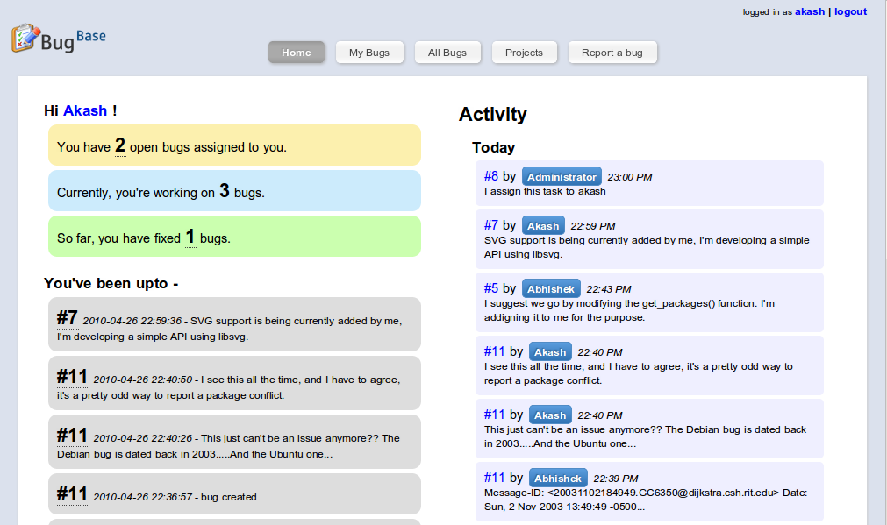
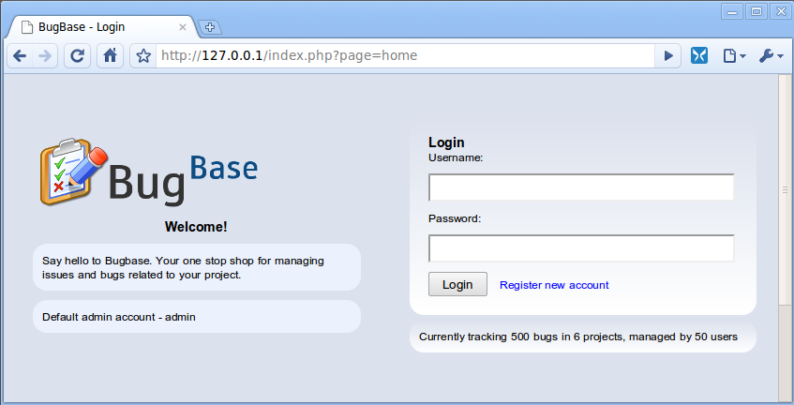
BugBase 1.0

Slide 3
Introduction

Slide 4
Introduction
Why track bugs/issues?

Slide 5
Introduction
Why track bugs/issues?
To get an idea of current state of affairs in a project

Slide 6
Introduction
Why track bugs/issues?
To get an idea of current state of affairs in a project
To share information with everyone

Slide 7
Introduction
Why track bugs/issues?
To get an idea of current state of affairs in a project
To share information with everyone
To make a newcomer’s life easier

Slide 8
Introduction
Why track bugs/issues?
To get an idea of current state of affairs in a project
To share information with everyone
To make a newcomer’s life easier
You’ve grown old and you wish to know how did you solve problem X back then

Slide 9
Introduction
Why track bugs/issues?
To get an idea of current state of affairs in a project
To share information with everyone
To make a newcomer’s life easier
You’ve grown old and you wish to know how did you solve problem X back then
To fight boredom and monotonacity

Slide 10
Introduction
Why track bugs/issues?
To get an idea of current state of affairs in a project
To share information with everyone
To make a newcomer’s life easier
You’ve grown old and you wish to know how did you solve problem X back then
To fight boredom and monotonacity
To participate in flame wars over commits

Slide 11
Introduction
Why track bugs/issues?
To get an idea of current state of affairs in a project
To share information with everyone
To make a newcomer’s life easier
You’ve grown old and you wish to know how did you solve problem X back then
To fight boredom and monotonacity
To participate in flame wars over commits
Why not?

Slide 12
So what’s BugBase?

Slide 13
So what’s BugBase?
Yeah what the hell is this thing?

Slide 14
So what’s BugBase?
Yeah what the hell is this thing?
BugBase is a simple bug/issue tracker written in PHP that keeps you from asking the big question –
“what the hell is going on?”
Or
“Could somebody tell me what happened last night, while I was smoking pot in the other room?”

Slide 15

So what’s BugBase?
Yeah what the hell is this thing?
BugBase is a simple bug/issue tracker written in PHP that keeps you from asking the big question –
“what the hell is going on?”
Or
“Could somebody tell me what happened last night, while I was smoking pot in the other room?”
What! Is this some of all bug trackers?

Slide 16
So what’s BugBase?
Yeah what the hell is this thing?
BugBase is a simple bug/issue tracker written in PHP that keeps you from asking the big question –
“what the hell is going on?”
Or
“Could somebody tell me what happened last night, while I was smoking pot in the other room?”
Maybe!
What! Is this some of all bug trackers?

Slide 17

So what’s BugBase?
Yeah what the hell is this thing?

Slide 18
So what’s BugBase?
Yeah what the hell is this thing?
There are 2 more projects with same name.

Slide 19
So what’s BugBase?
Yeah what the hell is this thing?
There are 2 more projects with same name.
One has to do with wireless, another one is a bug tacker itself

Slide 20
So what’s BugBase?
Yeah what the hell is this thing?
There are 2 more projects with same name.
One has to do with wireless, another one is a bug tacker itself
But wtf do we care about it. Everyone knows whats more awesome and whats not.

Slide 21
Features Tour

Slide 22
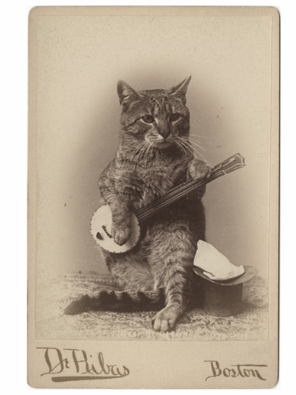
Features Tour
Demo Time!

Slide 23
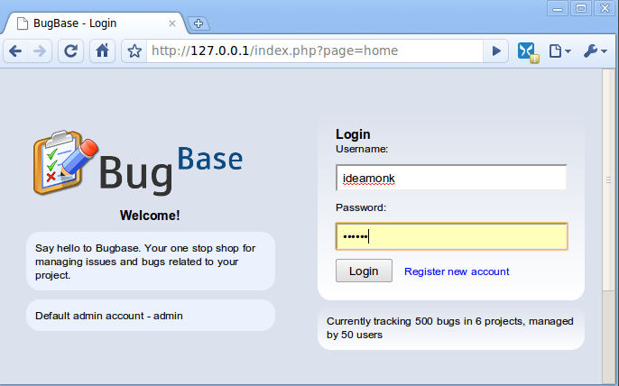
Features Tour
Login / Register

Slide 24
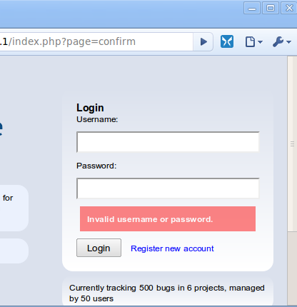
Features Tour
Login / Register

Slide 25
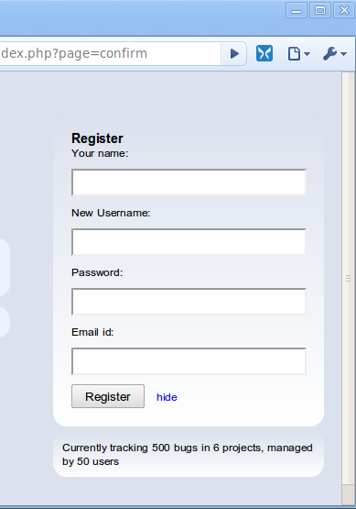
Features Tour
Login / Register

Slide 26
Features Tour
Dashboard / Home Page

Slide 27
Features Tour
Dashboard / Home Page
Getting an overview of WTF is going on

Slide 28

Features Tour
Dashboard / Home Page

Slide 29
Features Tour
Dashboard / Home Page
Your contributions quantified

Slide 30
Features Tour
Dashboard / Home Page
Your contributions quantified
Your recent work

Slide 31
Features Tour
Dashboard / Home Page
Your contributions quantified
Activity stream for today
Your recent work

Slide 32
Features Tour
Dashboard / Home Page
Your contributions quantified
Activity stream for today
Your recent work

Slide 33
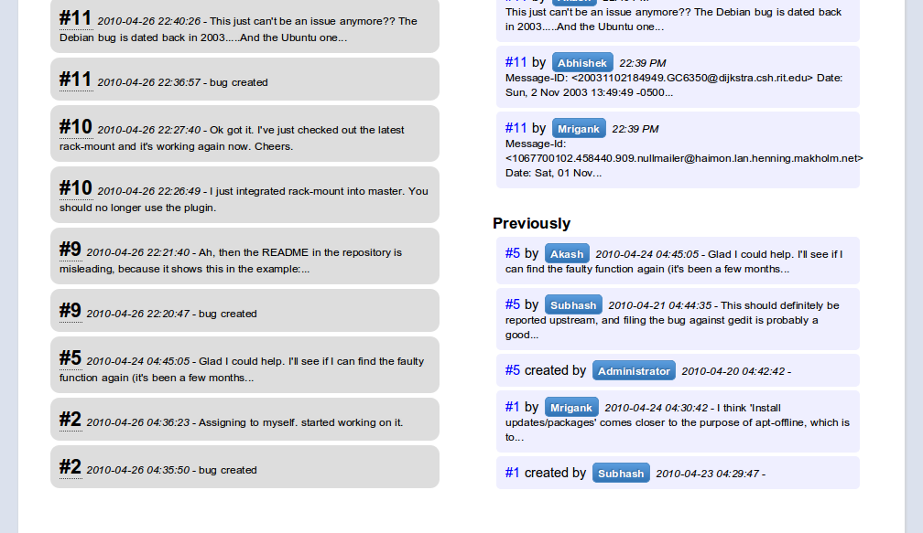
Features Tour
Dashboard / Home Page
Anything before today

Slide 34
Features Tour
My Bugs Page
Mind your own business

Slide 35
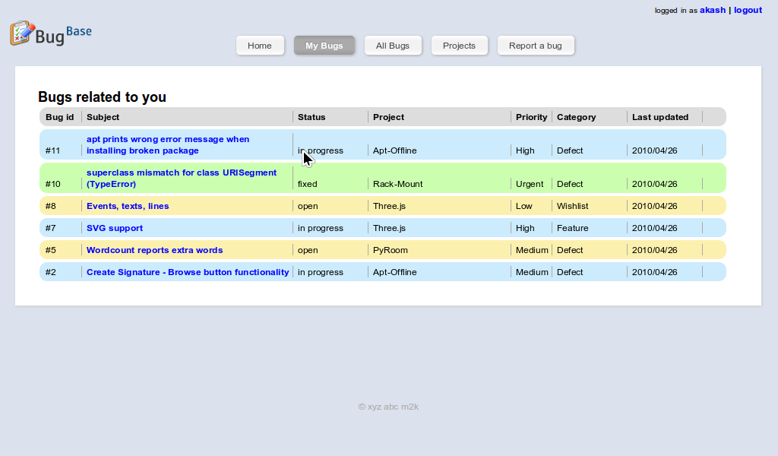
Features Tour
My Bugs Page

Slide 36
Features Tour
All Bugs
For the workaholic

Slide 37
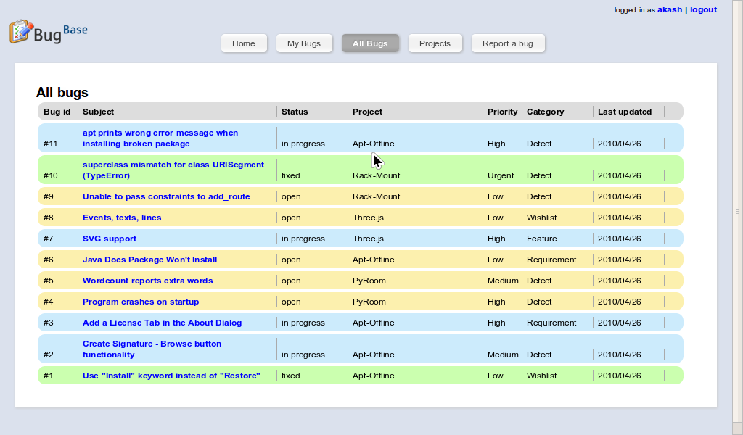
Features Tour
All Bugs

Slide 38
Features Tour
Projects
When people ask you
“Hey Joe, so what are you working on?”

Slide 39
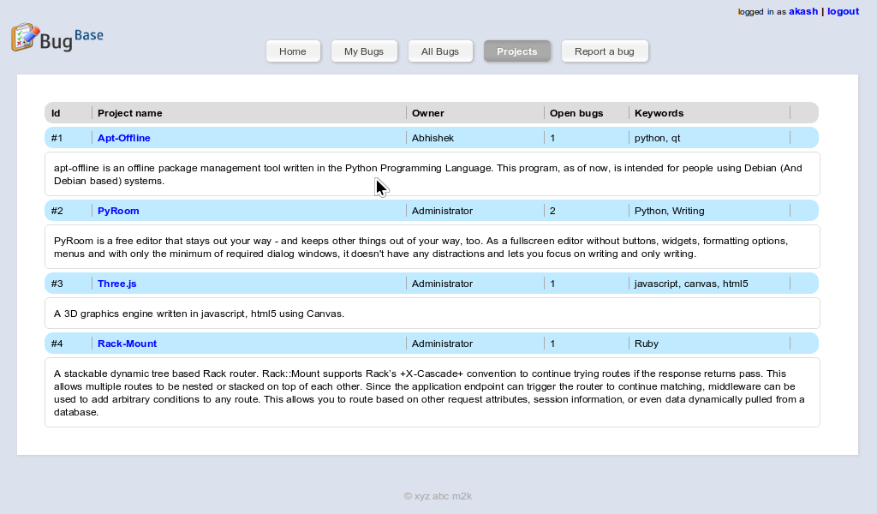
Features Tour
Projects

Slide 40
Features Tour
Report New Bug
Honey, I got a problem!

Slide 41
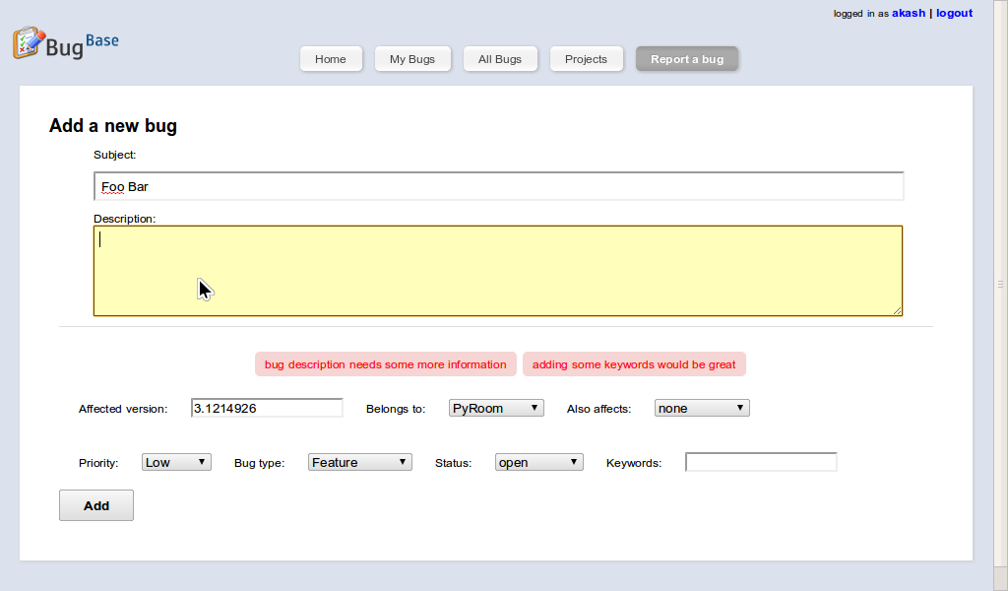
Features Tour
Report New Bug

Slide 42
Features Tour
The Bug Page
the Pandora’s Box?

Slide 43
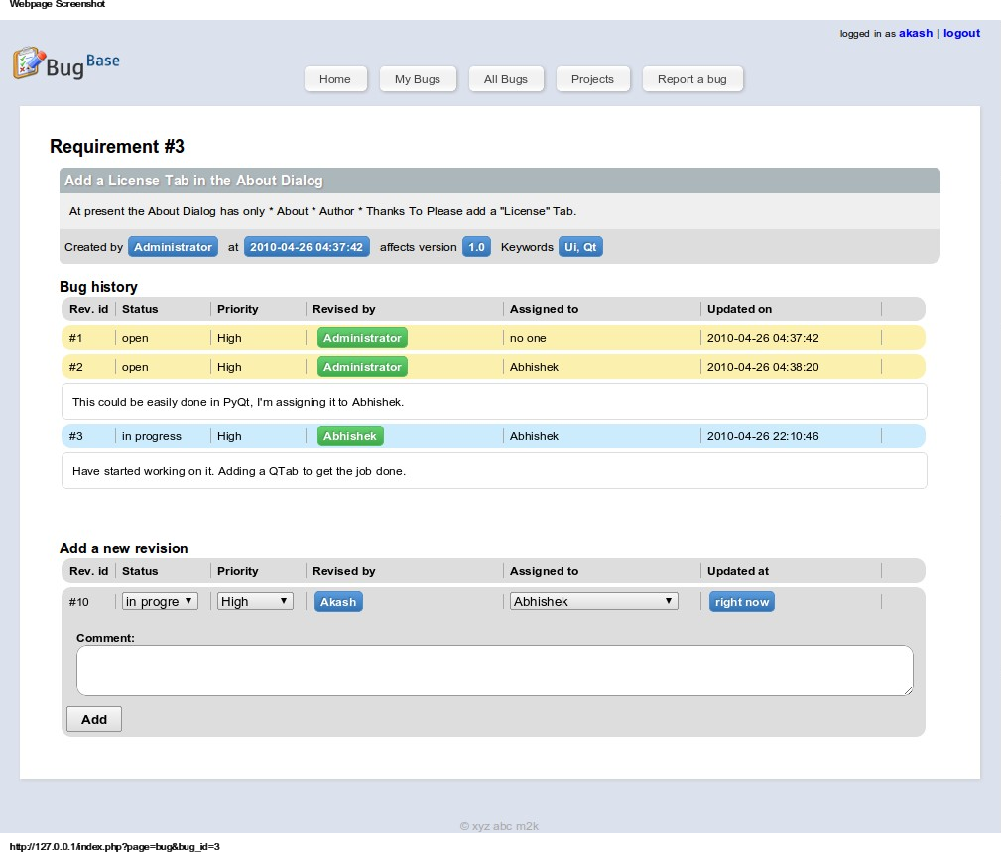
Features Tour

Slide 44
Features Tour
The mistake
The culprit
The glorious past
Yes you too can join the movement

Slide 45
Features Tour
Administration
Wait wait… then who manages all this ?

Slide 46
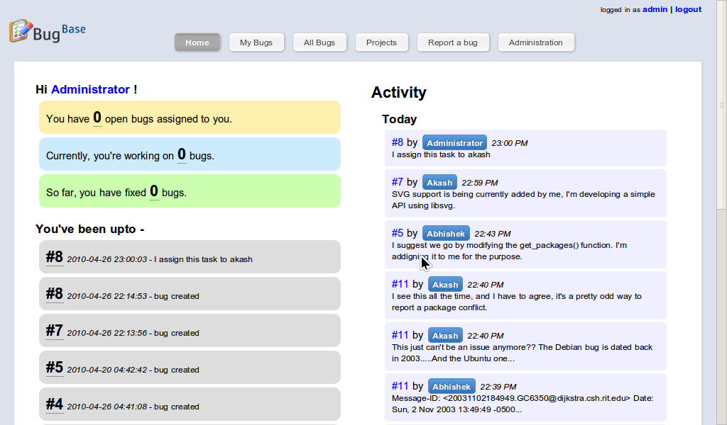
Features Tour
Administration
Command and Control

Slide 47
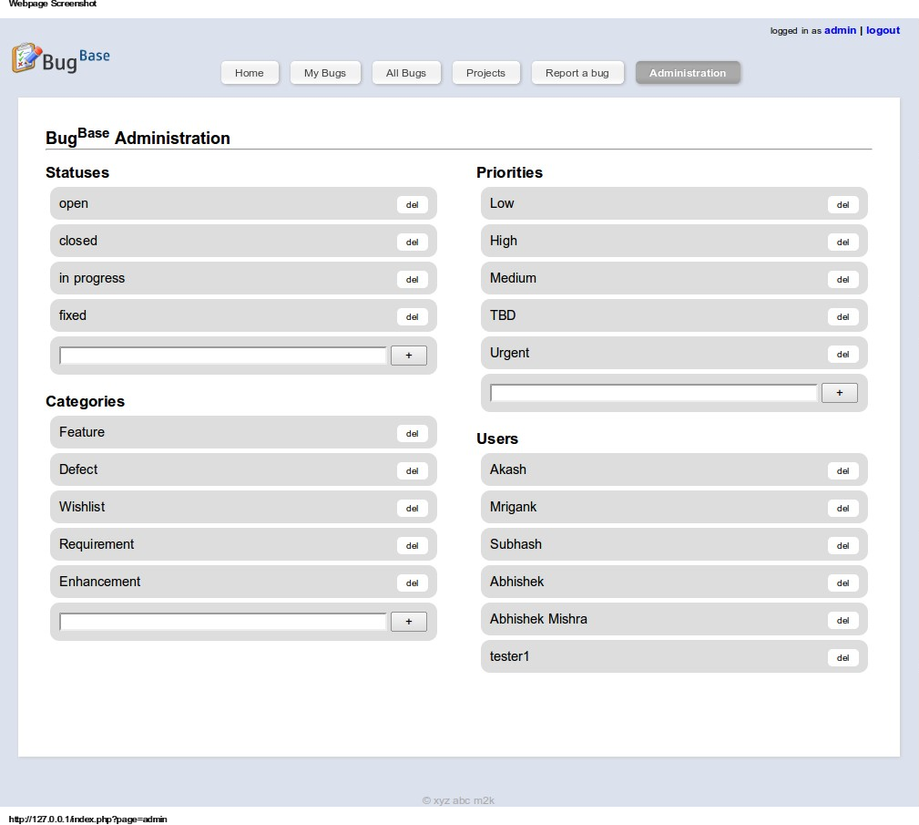
Features Tour
Administration

Slide 48
Features Tour
Administration
iCreate

Slide 49
Features Tour
Administration
iCreate
iDestroy

Slide 50
Features Tour
Administration
iRule :)
iCreate
iDestroy

Slide 51
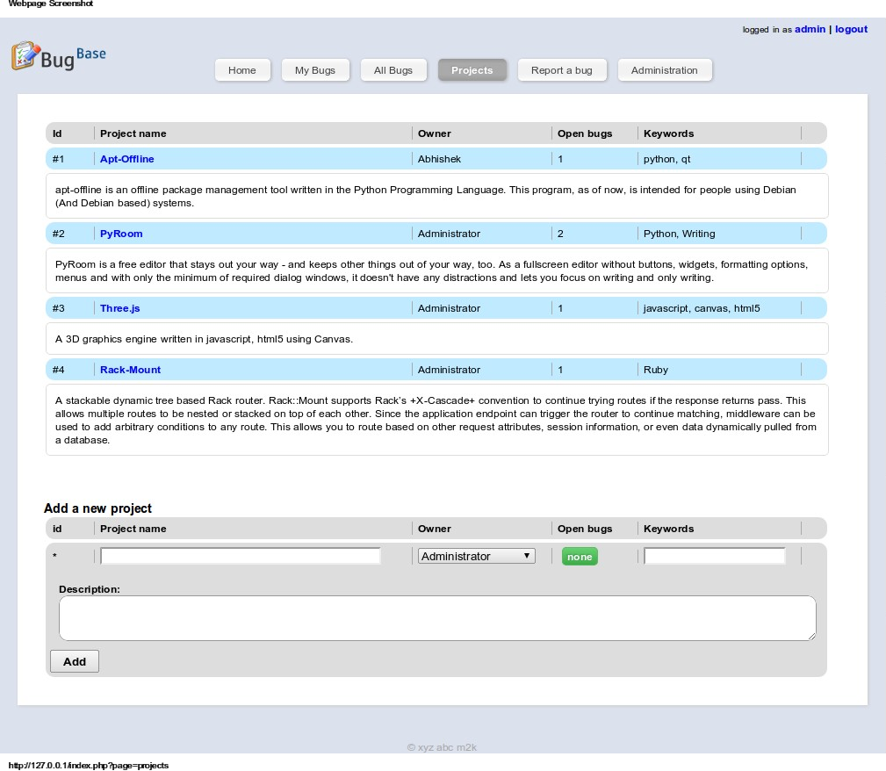
Features Tour
Administration
iProject

Slide 52
Behind the Scenes
What makes it work?

Slide 53
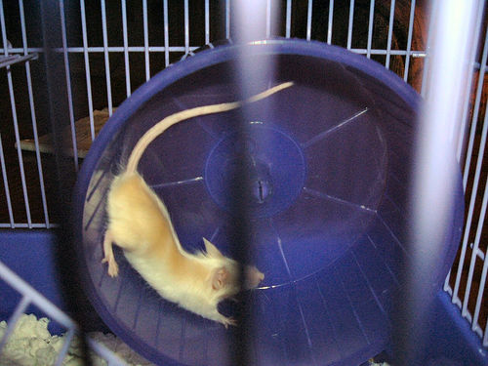
Behind the Scenes
What makes it work?

Slide 54






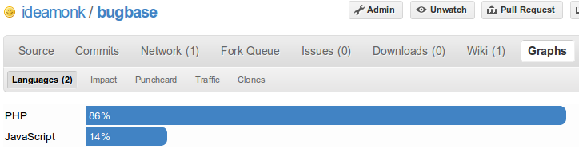
Behind the Scenes
What makes it work?

Slide 55
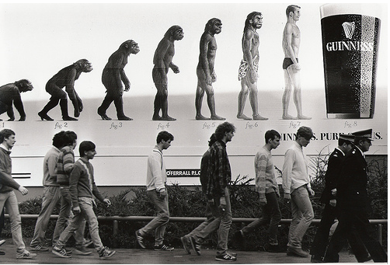
BugBase 1.0
Evolution

Slide 56

BugBase 1.0
Evolution
98 commits so far

Slide 57
BugBase 1.0
Evolution
98 commits so far
98 commits so far in 7 days => Low quality

Slide 58
BugBase 1.0
Evolution
98 commits so far
98 commits so far in 7 days => Low quality
98 commits so far in 7 days => Loopholes

Slide 59
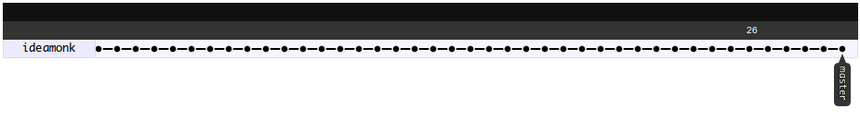
BugBase 1.0
Evolution
98 commits so far
98 commits so far in 7 days => Low quality
98 commits so far in 7 days => Loopholes
98 commits so far in 7 days => pending TODOs

Slide 60
BugBase 1.0
Evolution
98 commits so far
98 commits so far in 7 days => Low quality
98 commits so far in 7 days => Loopholes
98 commits so far in 7 days => pending TODOs
Wish this line to split out.

Slide 61

BugBase 1.0
Having said all that…

Slide 62

BugBase 1.0
You’re invited to…

Slide 63

BugBase 1.0
Fork BugBase
http://github.com/ideamonk/bugbase

Slide 64
BugBase 1.0
Development snapshot also active at
http://bugs.madetokill.com

Slide 65

BugBase 1.0
Adios!
Keep in touch – http://blog.ideamonk.in

